Slide 1




NeuroTube AI Assistant🎥
Hessah mohammed

Slide 2






Project pipeline:
MEMPHIS DESIGN
A brief history of a quirky design
1
2
3
4
5
6
Video Processing
and vector store
Audio
Transcribe
Process:
deliver:
Input
Split text → Answer questions
Summarize text → Create outputs
yotube URL
Convert video to audio track
Speech-to-text conversion
Text, Audio, Visual mind map

Slide 3




Key Features & Scientific Choices
gTTS
GPT-4

Slide 4
Challenges addressed:
01
02
Cost
Hallucinations
GPT-4 Cost Challenge
when the transcript is incomplete or contains poor audio quality.
when the question is out-of-scope (e.g., asking about content not present in the video).
when the model "guesses" instead of returning “I don’t know” when unsure.
03
Latency Challenges

Slide 5
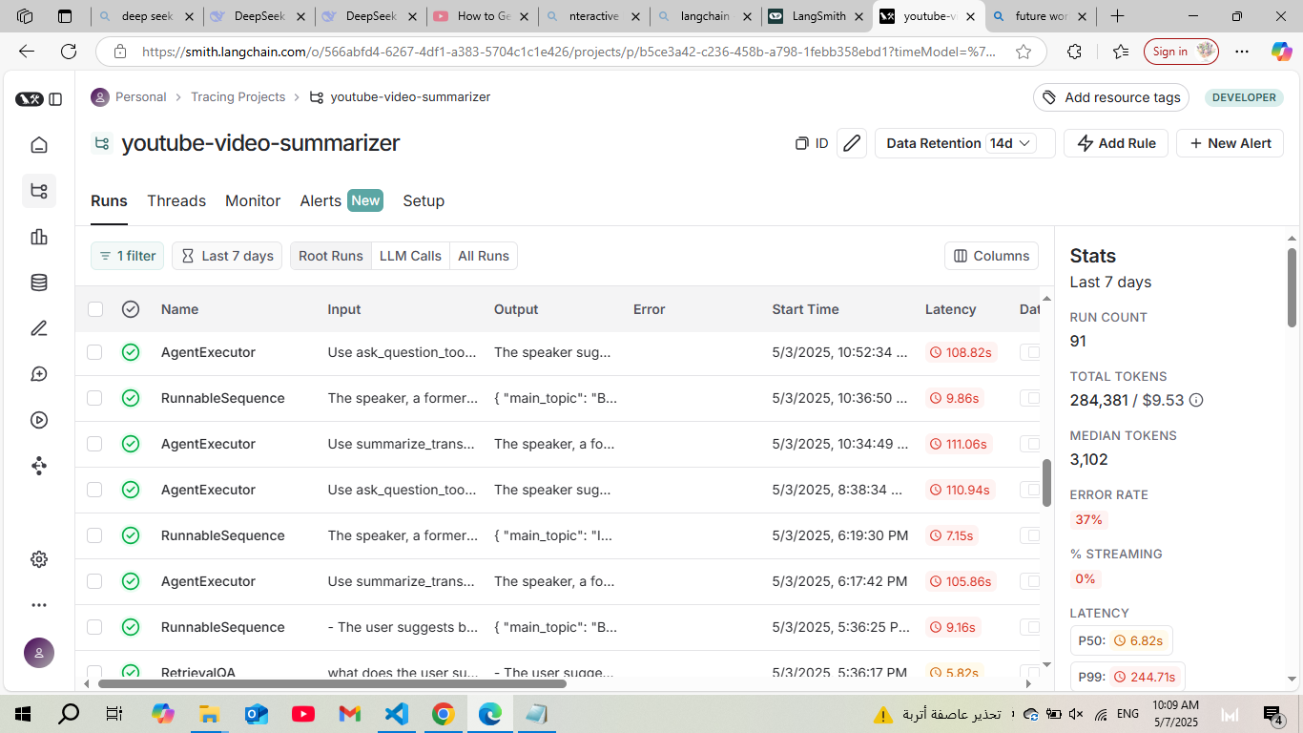
System Evaluation via LangSmith Monitoring:

Slide 6
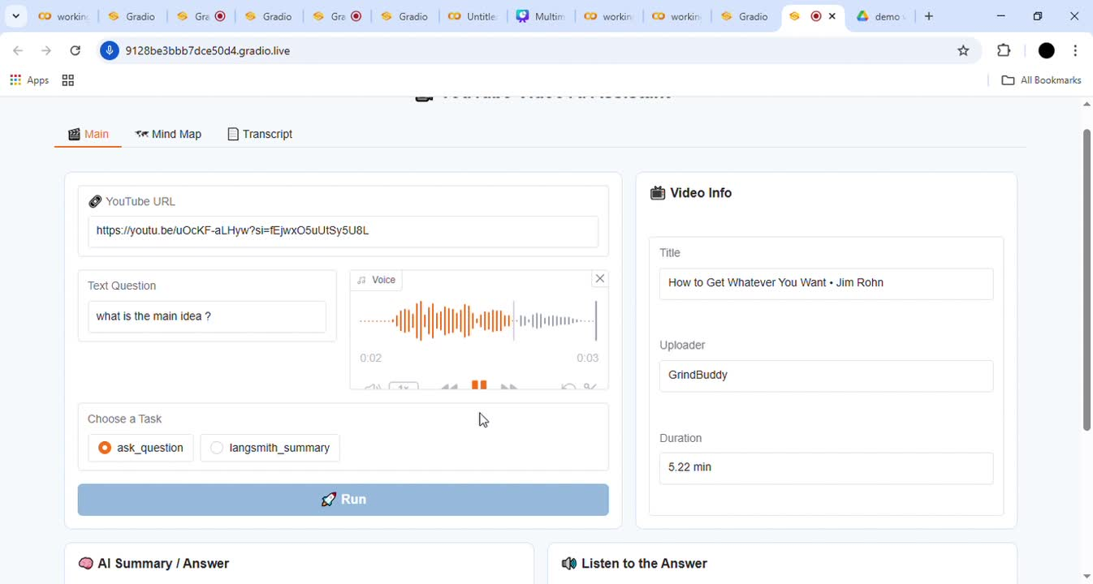
Gradio Interface Demo:

Slide 7
THANK
YOU!

Slide 8


Find me on LinkedIn :

